Slide 1
Analyzing the Impact of Slow-Wave and Spindle Coupling on Memory Consolidation During Sleep - MSc Project
Ananya
Kulkarni

Slide 2
Supervisors: Samuel Morgan, Anna Wick (External)
Examiner: Prof. Dr. Dirk Pflüger
Institute for Parallel and Distributed Systems, University of Stuttgart

Slide 3





Analyzing the Impact of Slow-Wave and Spindle Coupling on Memory Consolidation During Sleep

Slide 4
Introduction

Slide 5
EEG and Sleep Overview
Electroencephalography (EEG) records brain activity using scalp electrodes.
In sleep science, EEG helps track rhythmic patterns.

Slide 6
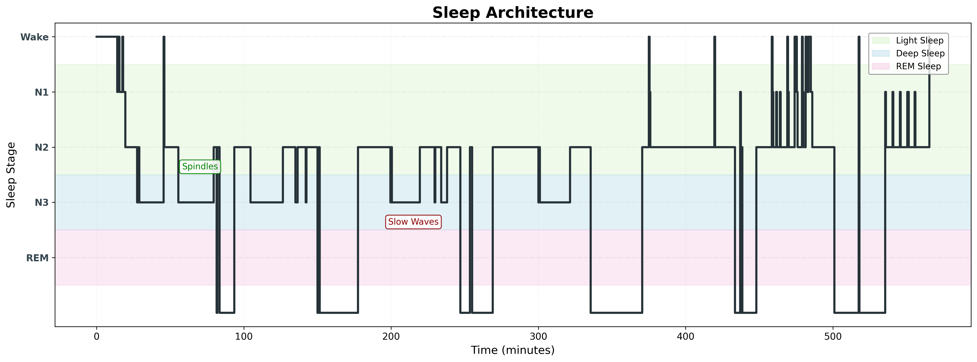
Sleep stages

Slide 7
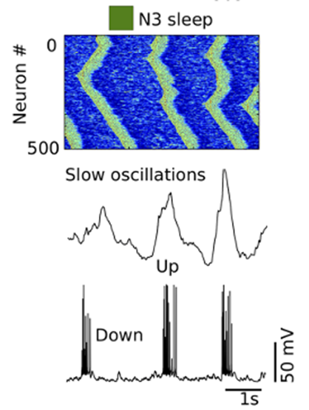
Slow Waves
Low-frequency, high-amplitude waves
Occur during N3 sleep stage
Each wave has a clear trough (peak), with onset and offset timing
Adapted from Mölle et al. (2011), Trends in Cognitive Sciences.

Slide 8
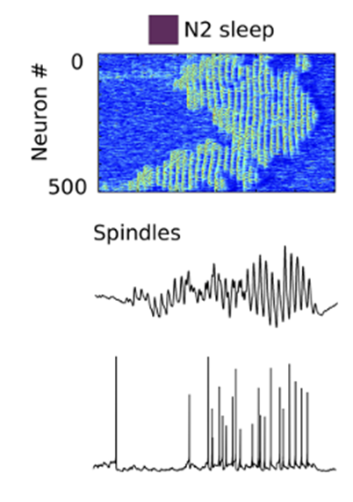
Sleep Spindles
Short bursts of fast oscillations
Occurs primarily during N2 and N3 sleep stages
Each spindle has a start, peak, and end
Adapted from Mölle et al. (2011), Trends in Cognitive Sciences.

Slide 9
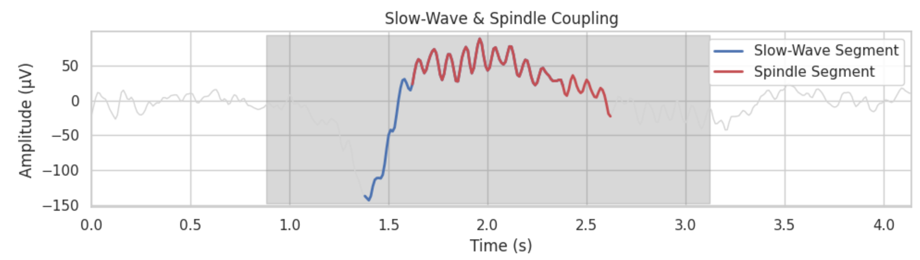
Slow Wave & Spindle Coupling
How It Works:
Hippocampus: Encodes and temporarily stores new memories during the day
Cortex: Long-term memory storage center
During deep NREM sleep, slow waves and spindles help coordinate memory transfer
Coupling = rhythmic coordination between hippocampus and cortex

Slide 10
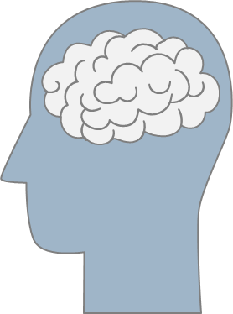
Why Sleep and Memory?
We sleep to rest — but the brain remains active.
During deep NREM sleep, the brain replays and reorganizes memories.
This process involves slow waves and sleep spindles.
Studies suggest that the precise timing between these rhythms boosts memory consolidation (Muehlroth et al. (2019)).
Most findings linking sleep rhythms to memory come from small, controlled lab studies — how well do they generalize?

Slide 11
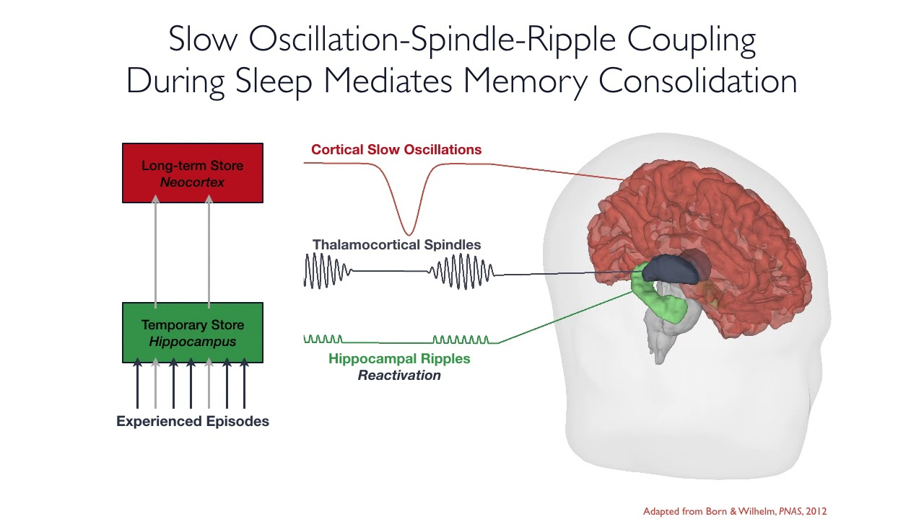
How Sleep Supports Memory Consolidation
Slow waves provide a timing signal for memory transfer
Spindles help organize when information gets sent
This process is thought to stabilize and strengthen memory traces. (Diekelmann & Born, 2010)
Adapted from Born & Wilhelm (2012), PNAS

Slide 12
Aim
Identify coupling between slow waves and spindles
Detect slow waves and sleep spindles from eeg recordings and quantify their coupling.
Test correlation between coupling and memory
Examine whether coupling metrics correlate with short-term recall and overnight memory retention across tasks.
Scale analysis across a large population
Use automated pipelines to process EEG and behavioral data from ~1900 participants.

Slide 13
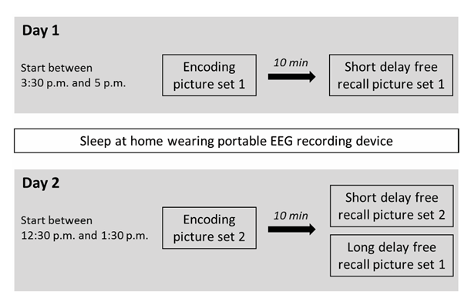
Dataset and Experimental Setup
~1900 participants across two experimental days.
Day 1 Tasks:
Emotional and neutral picture recall (Set 1).
Working memory task (n-back).
Procedural memory task (finger tapping).
Day 2 Tasks:
Recall of Set 1 and Set 2.
Repeat of n-back and finger-tapping tasks.
EEG Data:
4-channel EEG, EOG (eye movements), EMG (muscle activity).
Adapted from Ackermann et al. (2015).

Slide 14
Methodology

Slide 15
Preprocess Data
Detect Slow Waves and Spindles
Define Coupling Windows
Compute Coupling Metrics
Perform Correlation Analysis
Visualize Results

Slide 16

YASA: Yet Another Spindle Algorithm
What is YASA?
Open-source Python library for analyzing sleep EEG
Built on top of scientific Python tools like MNE
Widely used in sleep research to detect spindles, slow waves, etc.
Automatically identifies events using validated amplitude, duration, and frequency thresholds

Slide 17
Preprocessing & Detection
EEG was filtered (0.3–30 Hz) and downsampled to 100 Hz
Event detection was done using YASA (Python-based)
Slow waves filtered to 0.3–1.5 Hz; Spindles to 12–15 Hz using RMS threshold
YASA identified each event’s onset, peak, offset — adaptively per person

Slide 18
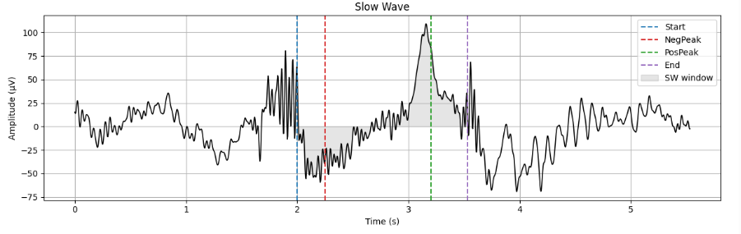
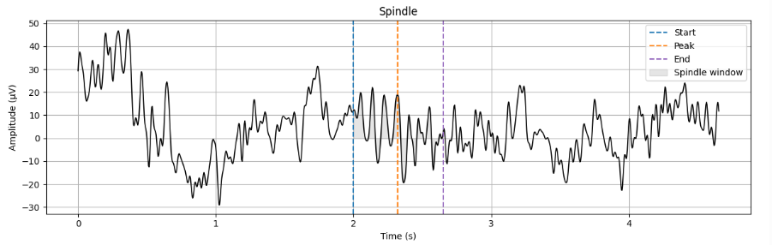

Slide 19
Coupling Metrics
Coupling defined using a ±1 second window around each slow wave trough Coupling window
→
Spindle Coupling Rate (%) → Percentage of all detected spindles whose peaks occur within the coupling window
Slow-Wave Coupling Rate (%) → Percentage of all detected slow waves that have at least one spindle peak within the coupling window.
Total Coupling Time (s) → Sum of the durations of all coupled spindle events for a participant.
Coupling % of N2/N3 → Total time spent in coupled spindles divided by total minutes of N2 and N3 sleep.

Slide 20
Results

Slide 21
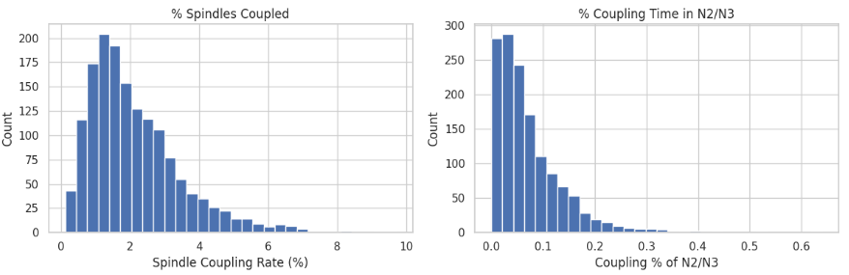
Coupling Metrics Distribution

Slide 22
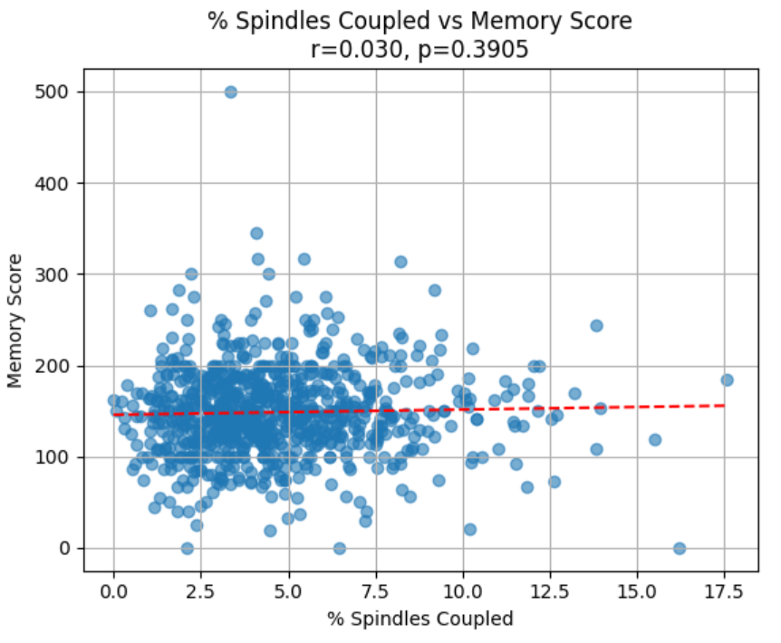
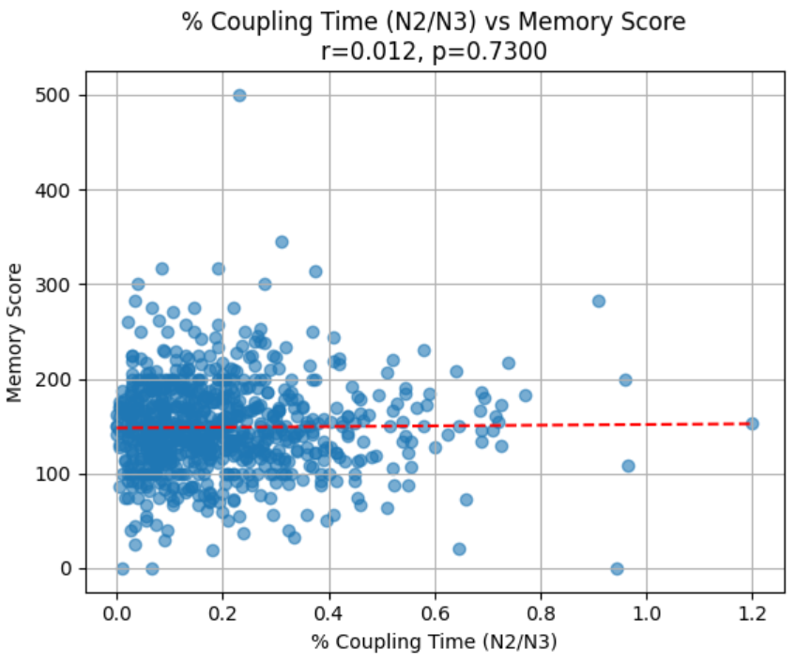
Statistical Methods: Pearson’s Correlation
Memory score = Total correct recalls across both days

Slide 23
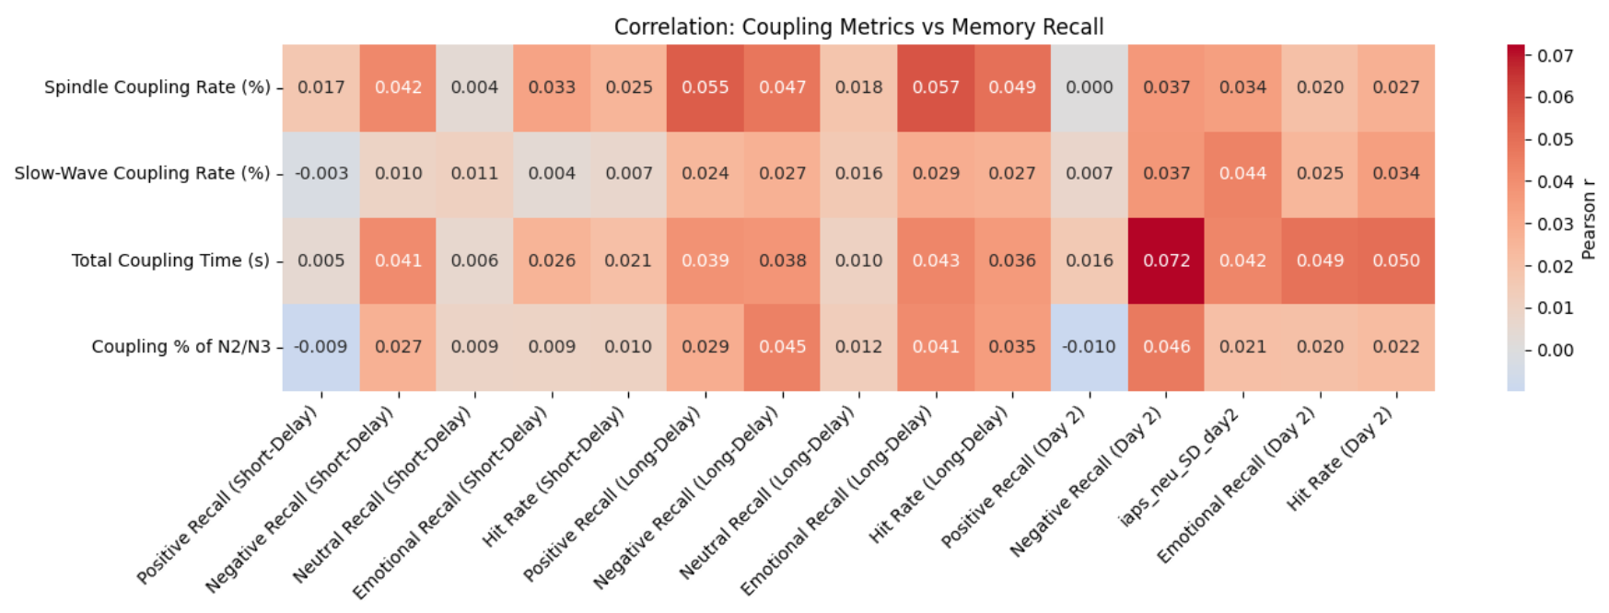
Correlation: Coupling Metrics Vs. Memory Scores
Tested whether slow wave–spindle coupling metrics were associated with memory performance. Metrics included coupling rate, total duration, and proportion of N2/N3 sleep in coupling.

Slide 24
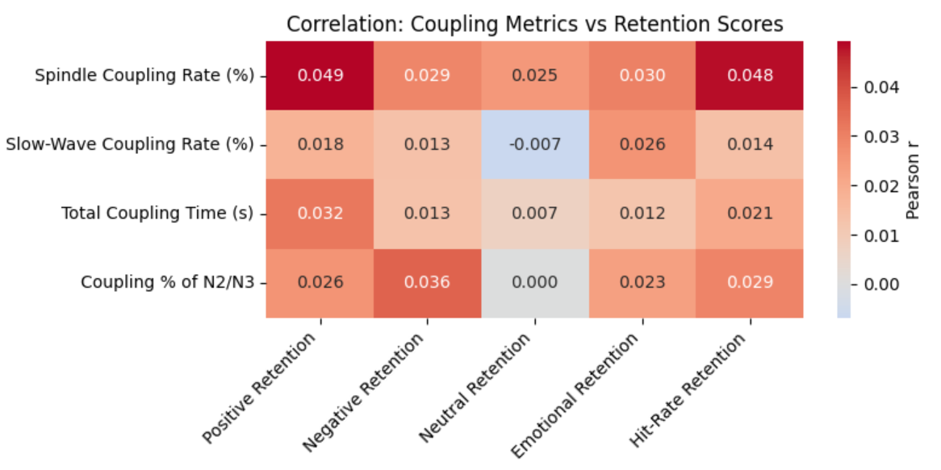
Correlation: Coupling Metrics vs. Retention Scores
Tested whether SO–spindle coupling metrics were related to memory retention scores across different types (e.g., emotional, neutral).
Retention = number of correctly recalled items on Day 2 that were also shown on Day 1.

Slide 25
Limitations

Slide 26
Limitations
🧭 Spatial Resolution
Only 4 EEG channels (Fz, Cz, C3, Pz)
May miss where coupling is most meaningful
🛠️ Detection Simplicity
Used fixed thresholds for amplitude and duration
May ignore subtle or atypical events
⏱ Coupling Metric Limitations
Used a basic ±1s window around slow wave trough
Treats all overlaps equally
Ignores precise timing, phase-locking, or spindle patterns
👥 Sample Bias
Only young, healthy adults (18-35 years), tested at home
Results may not generalize to older adults, clinical populations, or other types of memory tasks.

Slide 27
Future Outlook

Slide 28

Future Outlook
Use more electrodes (especially frontal) → better spatial coverage and signal quality.
Study older adults, clinical groups, and more diverse memory tasks
Adaptive thresholds or machine learning → for personalized, more accurate event detection.
Analyze coupling using flexible, time-varying methods → instead of fixed windows, use phase-based alignment.
Combine EEG with fMRI/MEG → to capture deeper brain dynamics across modalities.
🧪 Improve Data Collection:
💻 Refine Analysis Techniques:

Slide 29
Conclusion

Slide 30
Conclusion
Simple coupling metrics don’t predict memory – Neither coupling rate nor density showed meaningful correlations
Findings contrast prior small-scale studies – Earlier lab-based results don’t generalize to large, real-world cohorts
Highlights the limits of basic overlap measures – Fixed windows miss finer timing, phase relationships, and context
Demonstrates the complexity of sleep-memory dynamics – Sleep rhythms work in more nuanced ways than simple co-occurrence
Calls for more advanced analysis methods – Phase-based, multimodal, and personalized approaches are needed

Slide 31
References

Slide 32
References
Ackermann et al. (2015). No associations between sleep and episodic memory. Sleep, 38(6), 951–959.
Bastian et al. (2022). Spindle–SO coupling and memory connectivity. Hum Brain Mapp, 43, 4423–4438.
Diekelmann & Born (2010). The memory function of sleep. Nat Rev Neurosci, 11, 114–126.
Hahn et al. (2020). SO–spindle coupling and memory in development. eLife, 9, e53730.
Lang et al. (2008). IAPS: Affective ratings of pictures. Univ. of Florida, Tech. Rep. A-8.
Muehlroth et al. (2019). SO–spindle coupling and memory in adults. Sci Rep, 9, 1940.
Rasch & Born (2013). Sleep’s role in memory. Physiol Rev, 93, 681–766.
Schabus et al. (2004). Sleep spindles and declarative memory. Sleep, 27(8), 1479–1485.
Tononi & Cirelli (2006). Sleep function and synaptic homeostasis. Sleep Med Rev, 10(1), 49–62.
Walker & van der Helm (2009). Sleep and emotional processing. Psychol Bull, 135(5), 731–748.
Wilhelm et al. (2011). Sleep and memory in children. Learn Mem, 15(5), 373–377.

Slide 33

Ananya Kulkarni
e-mail
ananyakulkarni55@gmail.com
phone +49 (0) 17685982399
University of Stuttgart
M.Sc. INFOTECH

